Slide 2
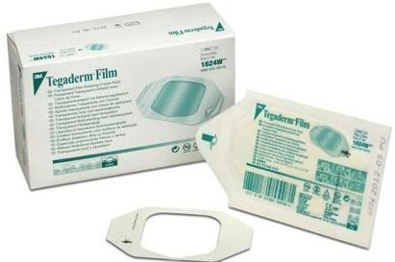
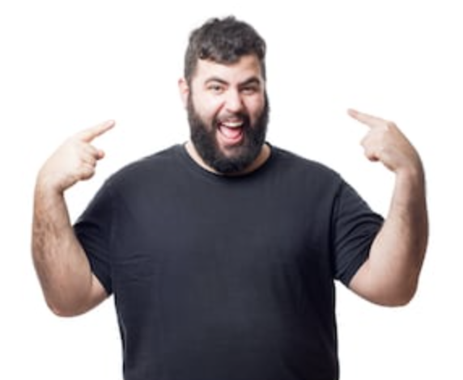
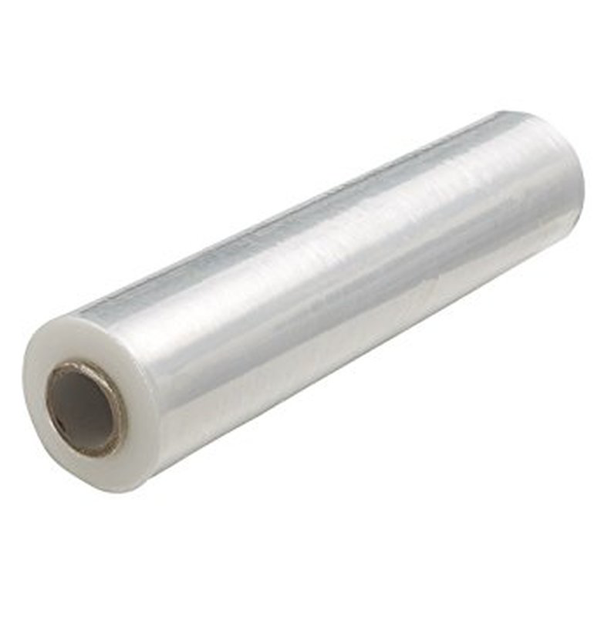
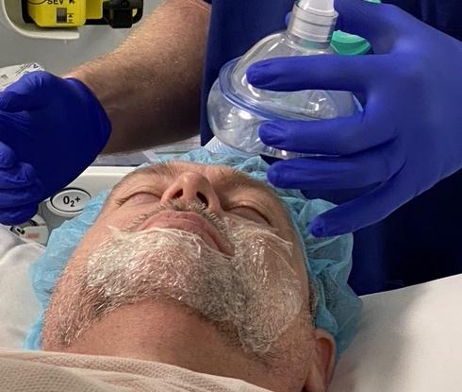
The Problem
Improving bag-mask ventilation in bearded patients
Globally more than 55% of men have facial hair or a beard
A beard is an independent predictor of impossible bag-mask ventilation
CURRENTLY NO DEVICE AVAILABLE

Slide 3
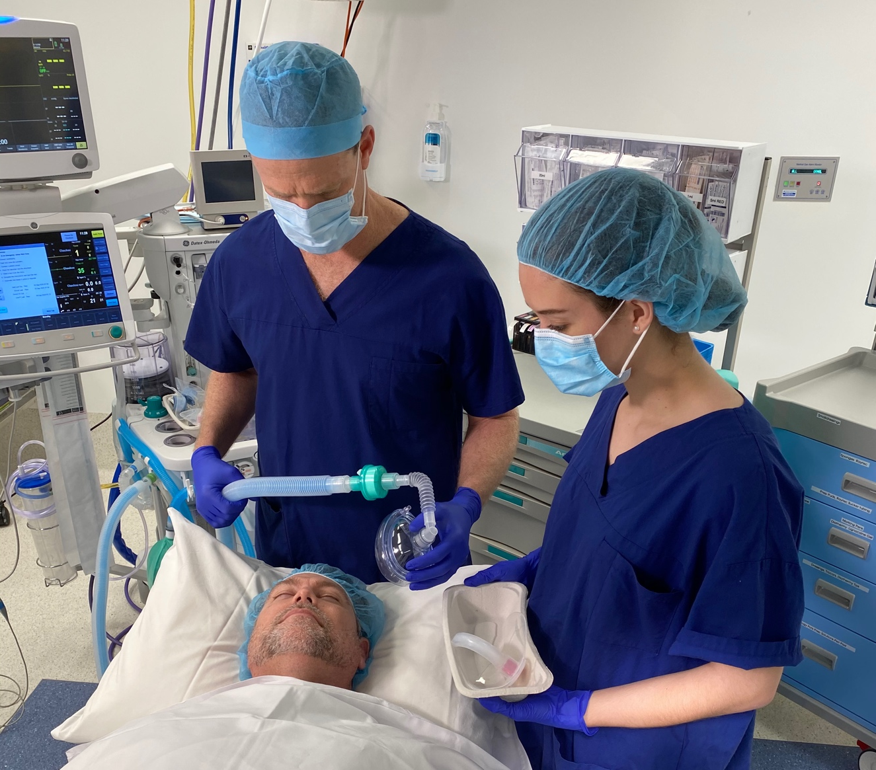
Company Innovation Overview
Dr Paul Scott developed the SAM Safety Seal device after encountering an ongoing problem; Difficulty bag mask ventilating bearded patients
With the invention of the SAM Safety Seal for use with Guedel additional benefits were revealed; protecting healthcare professionals from patients aerosolised secretions when patients are unable wear a surgical mask.

Slide 4
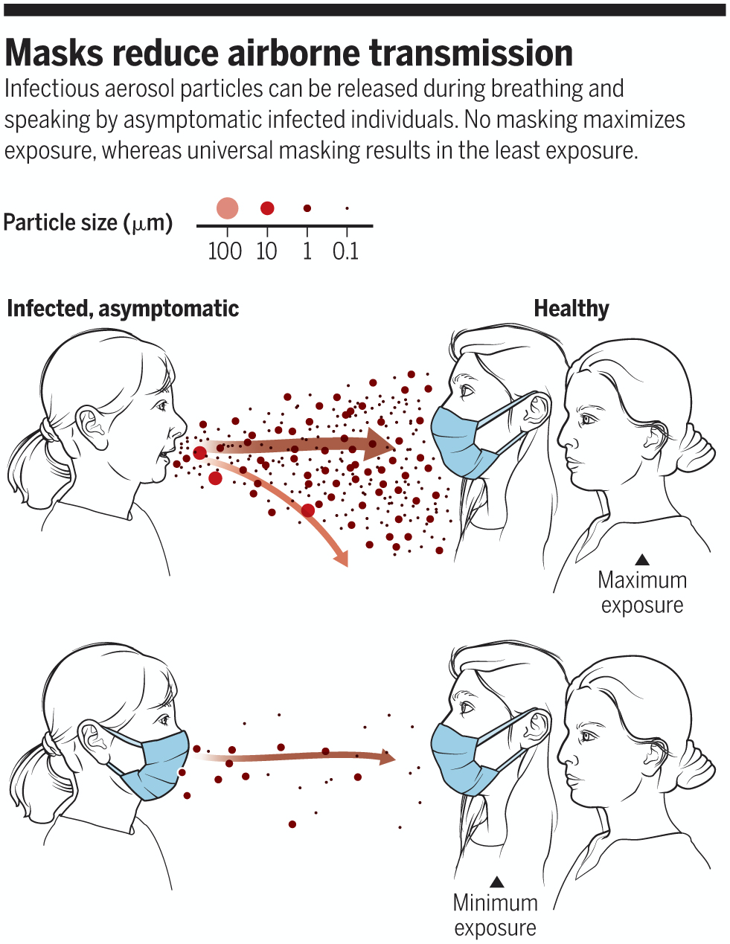
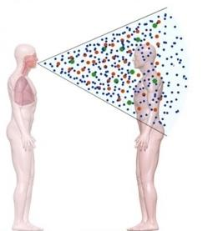
Why is Aerosolisation a Problem?
Bag-mask ventilation requires overcoming airway and lung resistance to deliver oxygen to the lungs
This requires delivering high pressures to the mouth to drive the movement of gas
This results in aerosolisation of airway secretions and risk to Health Care Workers
When a patient cannot wear a mask we need an alternative solution

Slide 5
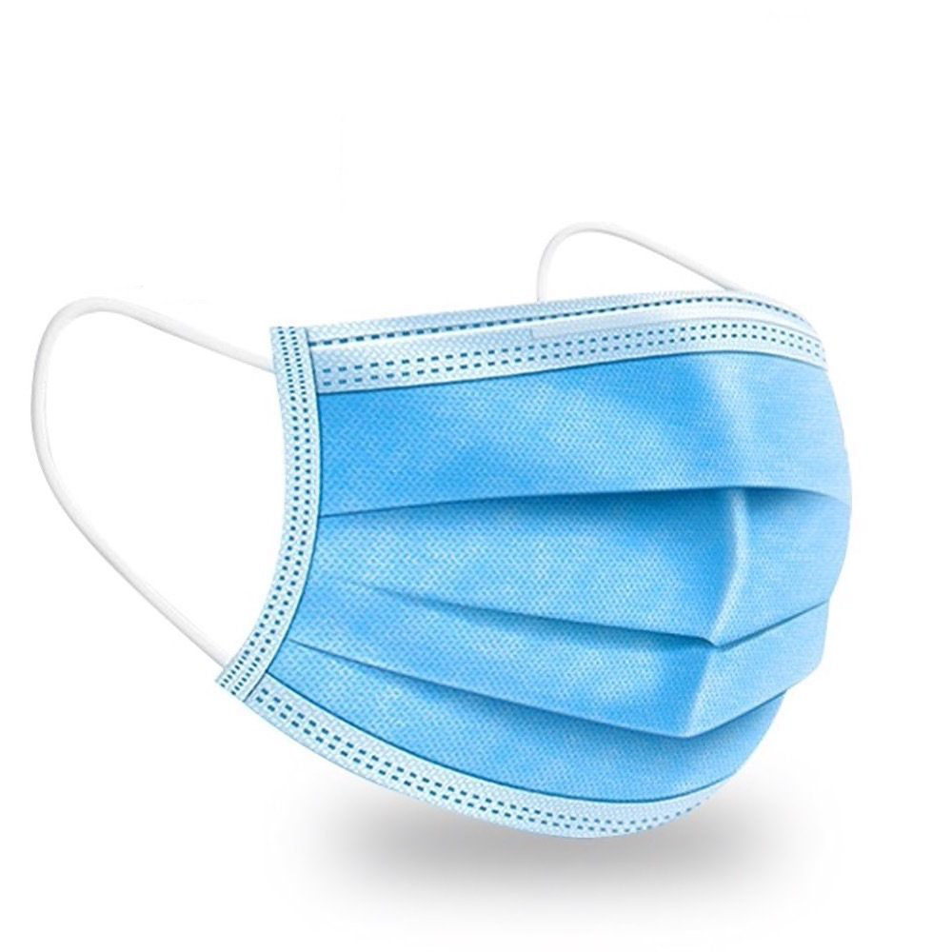
Increasing Risk with Covid-19
SAM assisting to reduce viral transmission
"70-80% of health care workers infected with COVID-19 during Victorias’ second wave of infections were caught at work”
In hospitals, 70% of infections were among nurses
Reference: CMO Andrew Wilson August 2020 ABC
Transmission through eyes and mouth
Risk to staff
Pressure on resources
PPE is worn by theatre staff, without controlling the risk at the source.
Notes:
Now transmission rate is not all due to
SARS in Toronto - 43% health care infection rate
The majority of SARS-CoV and MERS-CoV cases were associated with nosocomial transmission in hospitals and associated with the use of aerosol-generating procedures in patients with respiratory diseases. This places healthcare workers (HCW) including anesthesia professionals, intensivists, and nurses at a significant risk given the likelihood for a potential interface with droplets, sputum, or bodily fluids while performing routine procedures such as airway management.
processes that favor aerosolization of sputum in infected and potentially infected individuals in the perioperative setting represents a potential source of exposure to HCW. For the anesthesia professional and intensivist, the time period which represents the highest risk of exposure involves direct contact with respiratory droplets during airway management primarily during intubation and extubation.11, 12 Furthermore, inadequate personal protective equipment (PPE), improper use of PPE, and poor hand hygiene are potential factors that can lead to transmission to the bedside HCW.13
BJA - Anaesthetists must protect themselves during aerosol-generating medical procedures.
Guardian - Doctors who are dealing most closely with Covid-19 patients – A&E medics, anaesthetists and specialists in acute medicine and intensive care – are most worried.

Slide 6
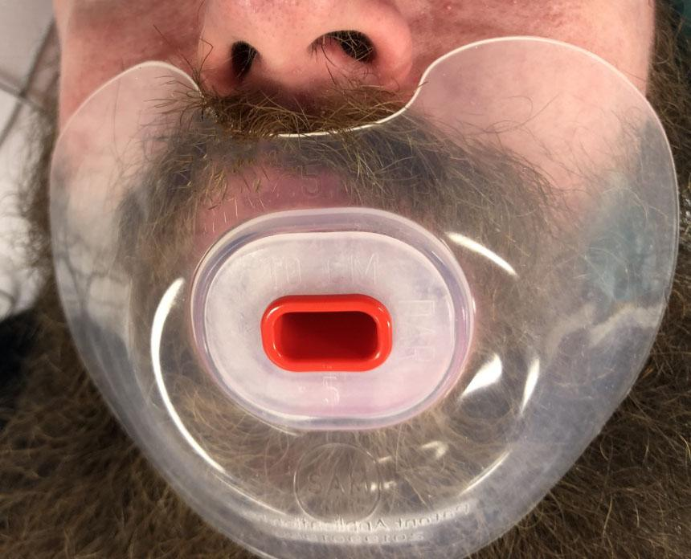
The Solution
SAM-SS was developed to address critical safety issues identified with bag-mask ventilating:
Patients with facial hair
Aerosolisation of patients airway secretions infection risks to HCP’s
Notes:
Last year I had a case where I was unable to bmv a bearded patient. The following day I…..everywhere I looked were bearded men that were potential problems for me.
This need has been escalated because of Covid thus the push to get to market. My INVENtion.
We can see other applications that have not yet been tested or trailed.

Slide 7
Market Response
“Ah Ha! Of course. Could it work for endoscopy? ”
Endoscopy nurse
“Patients with a beard cause me anxiety, now I can be comfortable I can ventilate them” ANAESTHETIST
“Great Queensland success story in a time of need!
I want this, we need this, I would use this”
PROFESSOR JOHN FRASER
“This would work!”
Gastroenterologist
“This would help protect us during endoscopy!”
Anaesthetist
“This will be the go-to device in every ambulance”
INTENSIVE CARE PARAMEDIC
Notes:
I have spoken at length with senior HCW who would all use this.

Slide 9
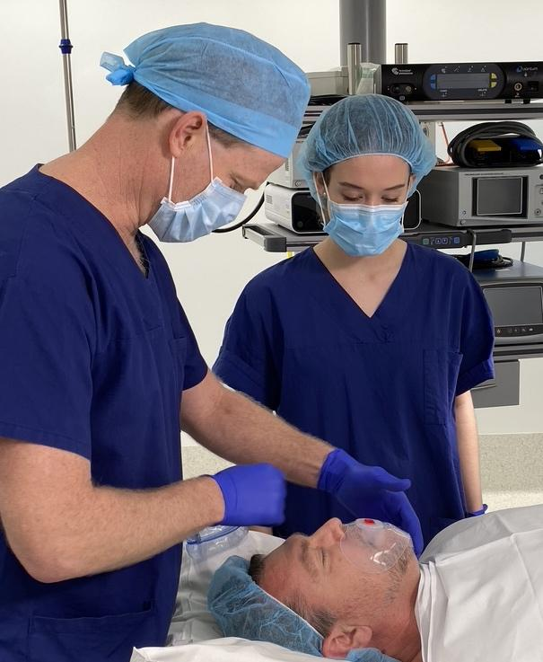
Evaluating SAM Safety Seal Guedel (SSSG)
Assess the use of the SSSG in
Patients with beards
Patients that are anaesthetised and paralysed
Suit a Size 10cm RED Covidien Guedel airway ONLY
In comparison to standard practice when bag mask
Ventilating a bearded patient

Slide 10
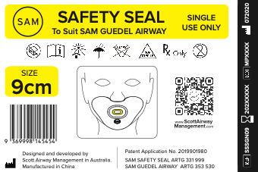
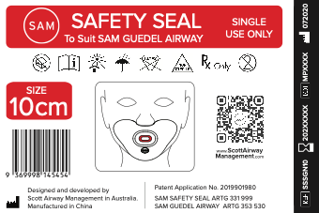
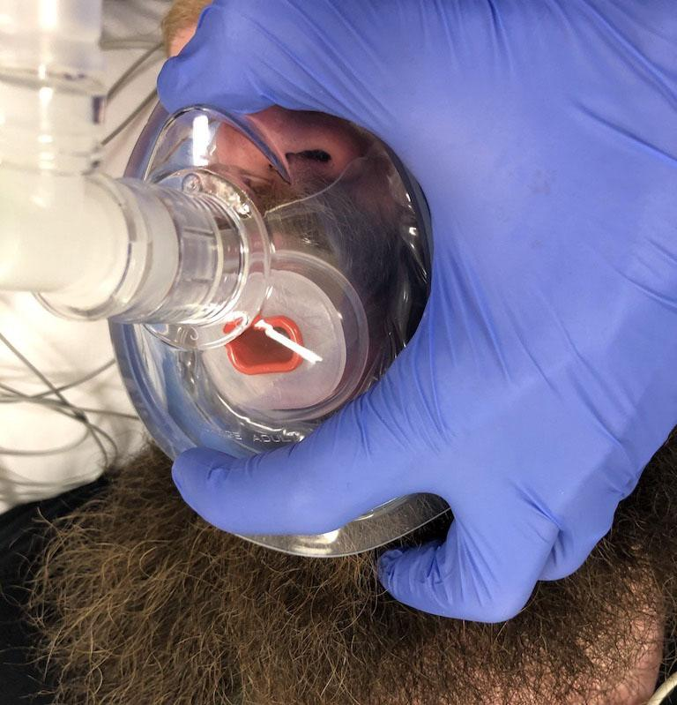
How to use the SSSG
The Guedel airway is fitted flush to the mouth of the SAM SS
Place the SAM SSSGN with guedel to improve seal during BMV and protect HCP form aerosolised saliva
Instructions on how to use the device are available by scanning the QR code.
Notes:
Now transmission rate is not all due to
SARS in Toronto - 43% health care infection rate
The majority of SARS-CoV and MERS-CoV cases were associated with nosocomial transmission in hospitals and associated with the use of aerosol-generating procedures in patients with respiratory diseases. This places healthcare workers (HCW) including anesthesia professionals, intensivists, and nurses at a significant risk given the likelihood for a potential interface with droplets, sputum, or bodily fluids while performing routine procedures such as airway management.
processes that favor aerosolization of sputum in infected and potentially infected individuals in the perioperative setting represents a potential source of exposure to HCW. For the anesthesia professional and intensivist, the time period which represents the highest risk of exposure involves direct contact with respiratory droplets during airway management primarily during intubation and extubation.11, 12 Furthermore, inadequate personal protective equipment (PPE), improper use of PPE, and poor hand hygiene are potential factors that can lead to transmission to the bedside HCW.13
BJA - Anaesthetists must protect themselves during aerosol-generating medical procedures.
Guardian - Doctors who are dealing most closely with Covid-19 patients – A&E medics, anaesthetists and specialists in acute medicine and intensive care – are most worried.

Slide 11
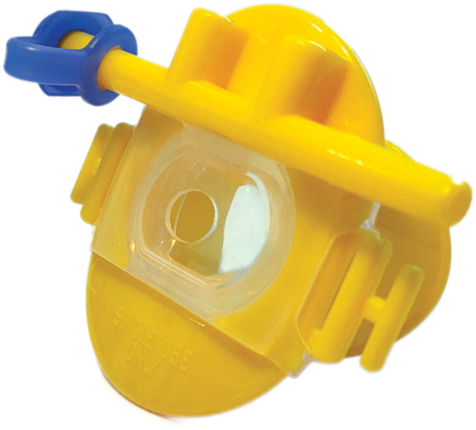
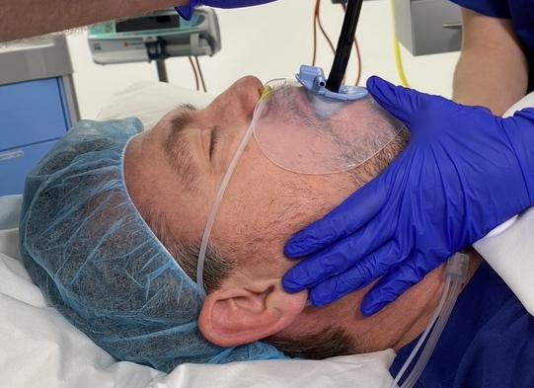
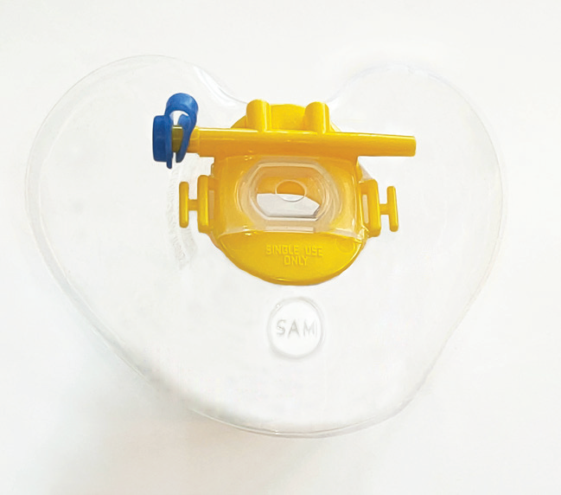
SAM Safety Seal Bite Block
Protecting HCPs from risk of infection via aerosolised particles is an unmet need
Not Just a BMV problem*
Endoscopy
Trans Oesophageal Echo
Bronchoscopy –
where suction is not required
* Feedback from endoscopy HCPs, the SAM SSBB also aids teeth protection

Slide 12
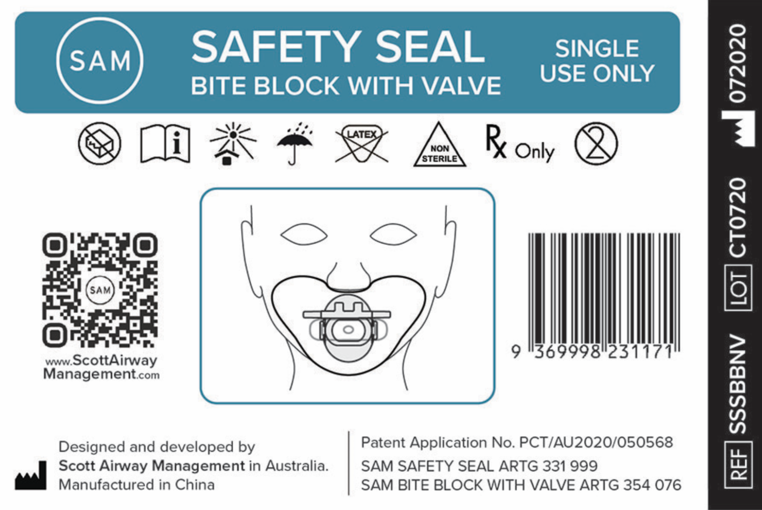
How to use the SAM Safety Seal Bite Block
The SAM Safety Seal has a bite block and valve fitted
Ensure that this has a flush fit before use
The valve can be removed at the right hand side of the bite block lug

Slide 13
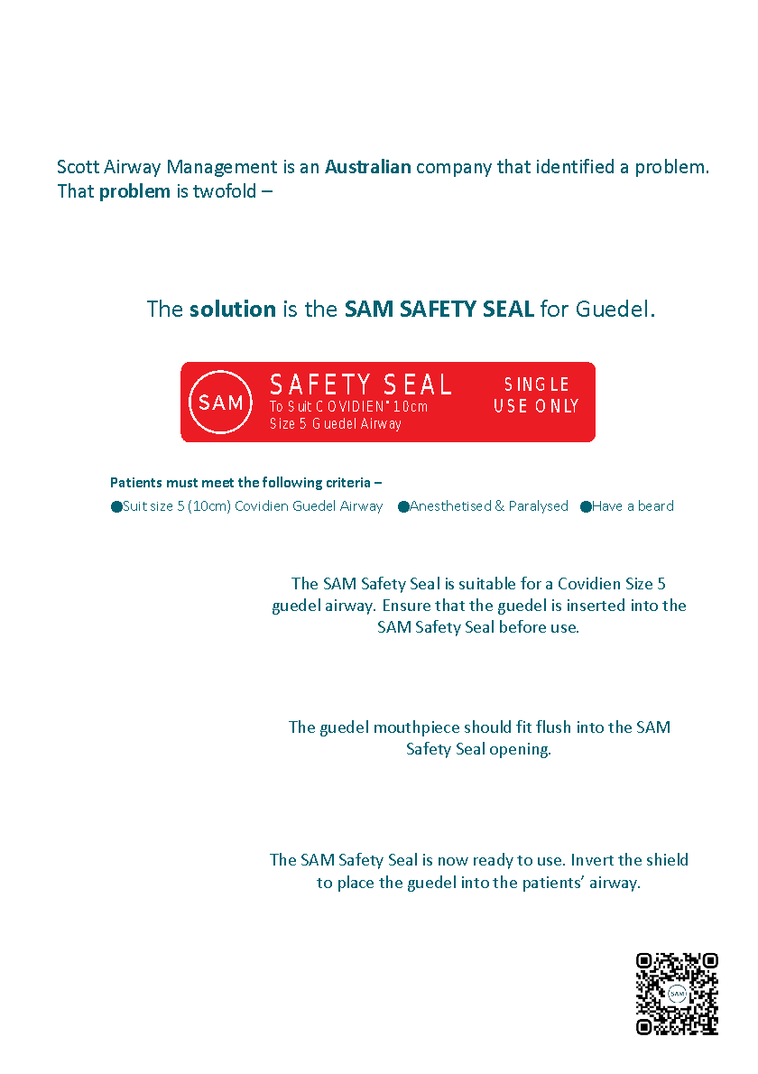
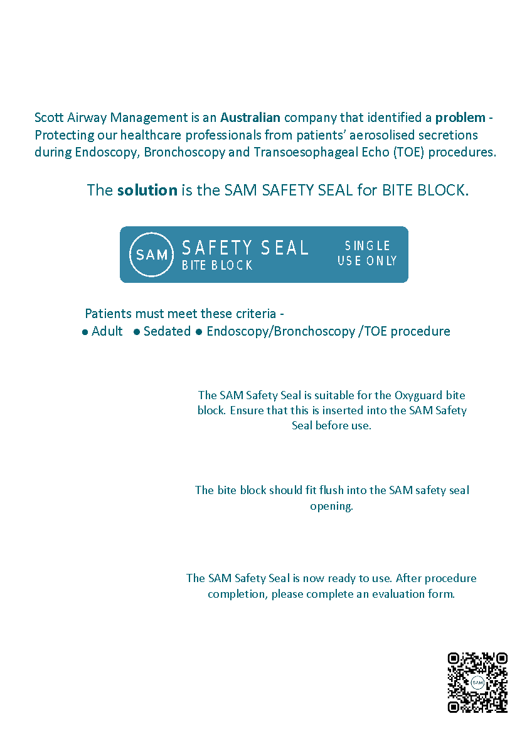
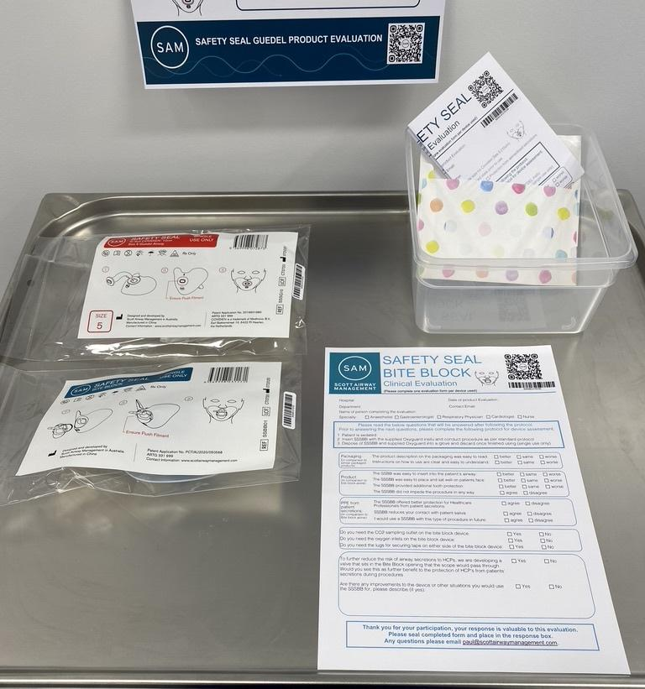
Product Evaluation
Posters
Evaluation Forms
Envelopes
Product

Slide 14
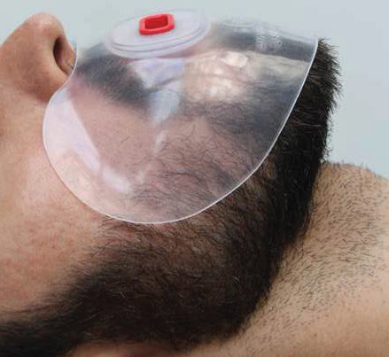
We need your help!
Remind doctor to use
Correct product
Correct Size Guedel
Correct patient
Guide on use
Trouble shooting
Ensure paperwork complete and placed into the response box.

Slide 15
THANK YOU IN ADVANCE
SAM Safety Seal
Because infection control isn’t over, when patients are under.

